Slide 1
;Docswave User Guide
Make your day-to-day tasks more enjoyable!
Softwareinlife Inc.
support@docswave.com

Slide 2
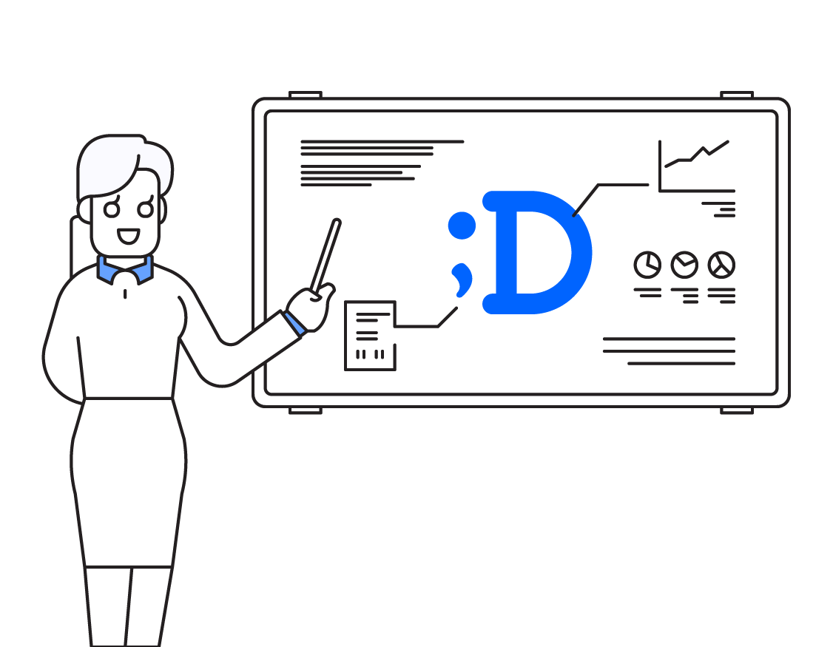
Starting ;Docswave
My Info
Workflow Document
Board Collaboration
Issue a certification
Member Info & Shared Contacts

Slide 3
1. Starting ;Docswave
Sing in with Google
Dashboard
Settings

Slide 4
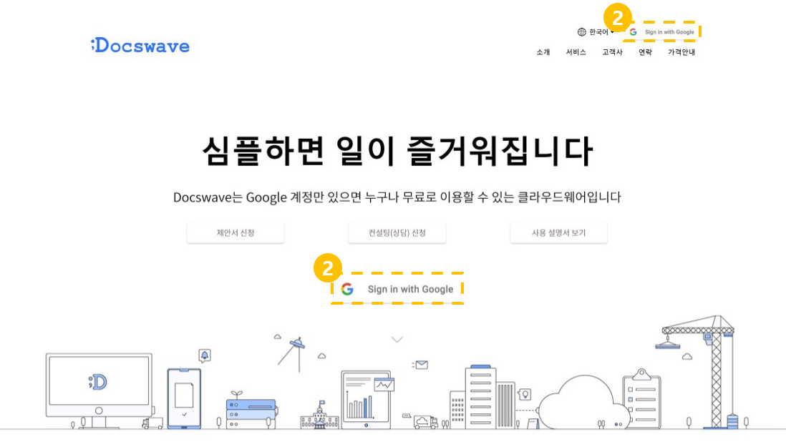
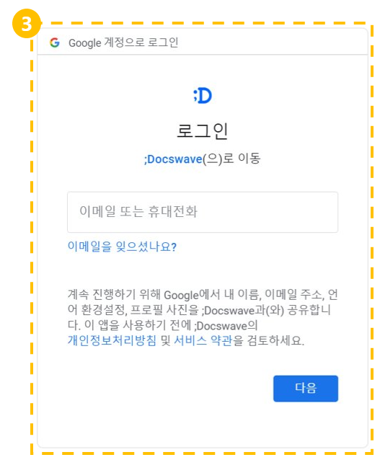
Starting ;Docswave
Sign in with Google
Visit ;Docswave Homepage.
Click [Sign in with Google] Button..
Log-in with Google account.

Slide 5
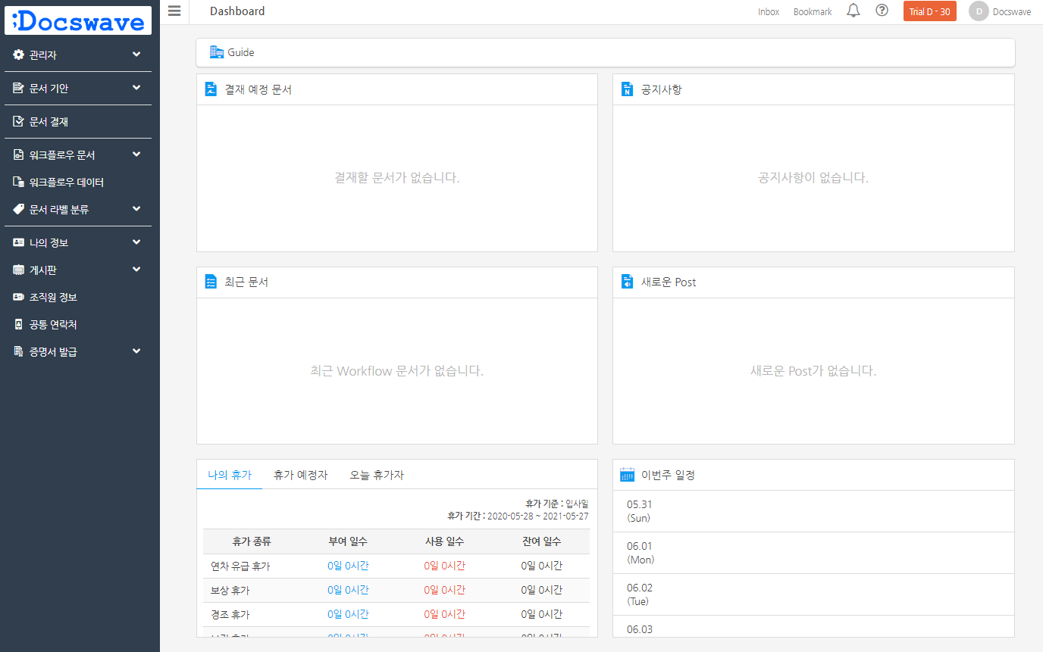
Starting ;Docswave
Dashboard
This is the main screen when you log-in ;Docswave.
‘You can check ‘Documents in workflow’, ‘Notifications’, and ‘Recent documents’, etc.
‘Vacation list’ and ‘Weekly schedule linked with calendar’ is provided in Premium service.

Slide 6
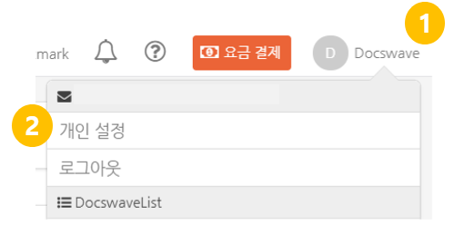
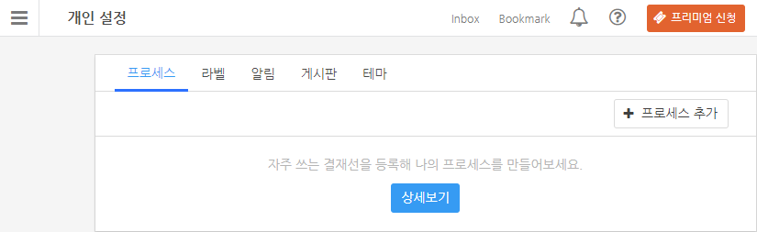
Starting ;Docswave
Settings
Click your name in the upper-right corner of the main screen.
Click ‘Setting’,
and it moves to personal settings.

Slide 7
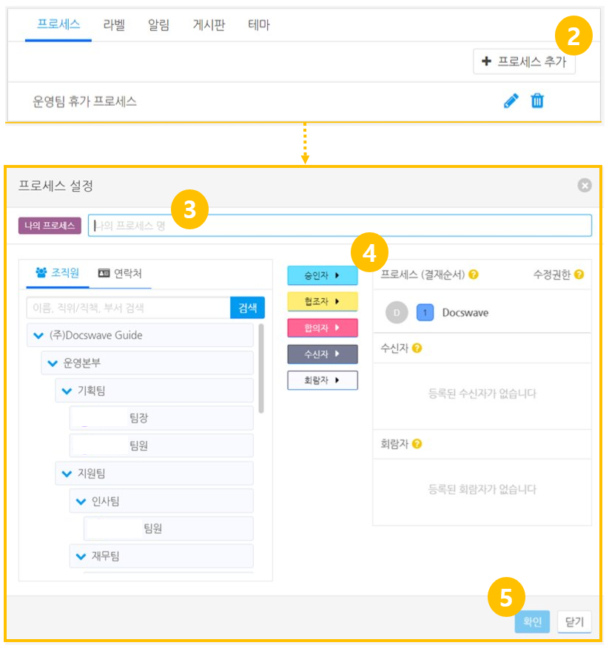
Starting ;Docswave
Process Setting
Click ‘process’ tab.
Click ‘Add process’ button
Type ‘Name of My Process’
Set your processes
Click ‘Confirm’ button.

Slide 8
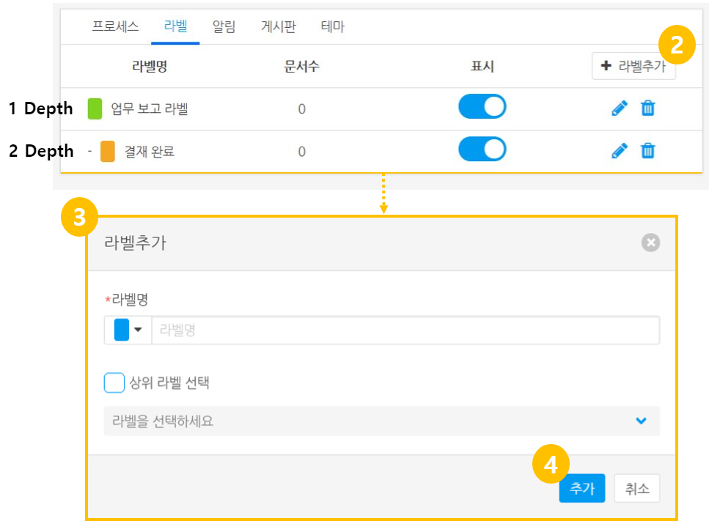
; Starting ;Docswave
Document label usage instruction
You can add labels, designate them to documents, and sort out documents with labels.
Labels are displayed in personal document box only.
Admins can't designate common document labels.
Click 'Label' tab.
Click 'Add a label' button
Decide label name, color, and parent label.
Click 'Confirm' button.

Slide 9
2. My Info
Setting my HR information
Checking my Vacation history
Checking my spending documents
Checking my purchase information

Slide 10
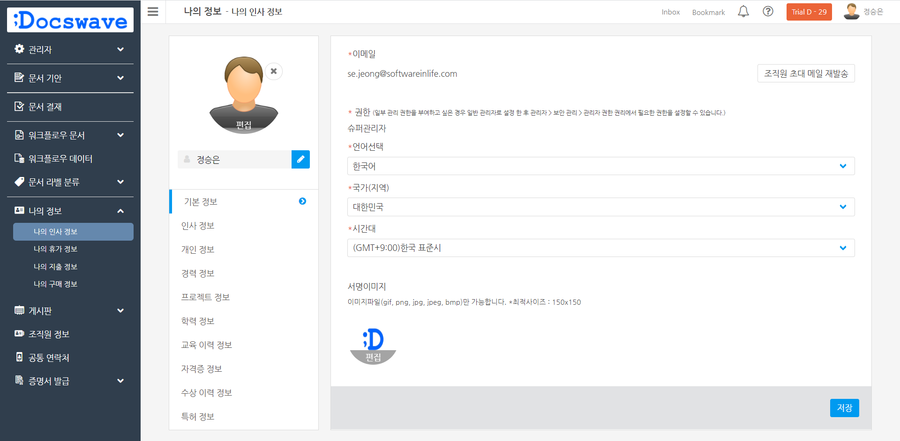
My Info
Setting my HR information (Language , Country)
Go to [my profile – Basic information] tab.
Select specific settings you want to change.
  Language : Korean, English, Japanese, Chinese, Spanish & Vietnamese.
  Country(region)
  Time zone.
Click ‘Save’ button on bottom side.
2
1
3

Slide 11
My Info
Setting my HR information (signature)
Go to [my profile – Basic information] tab.
Click [Edit] on ‘the signature image area’.
Upload an image from PC.
click the [Save] .
1
2
3

Slide 12
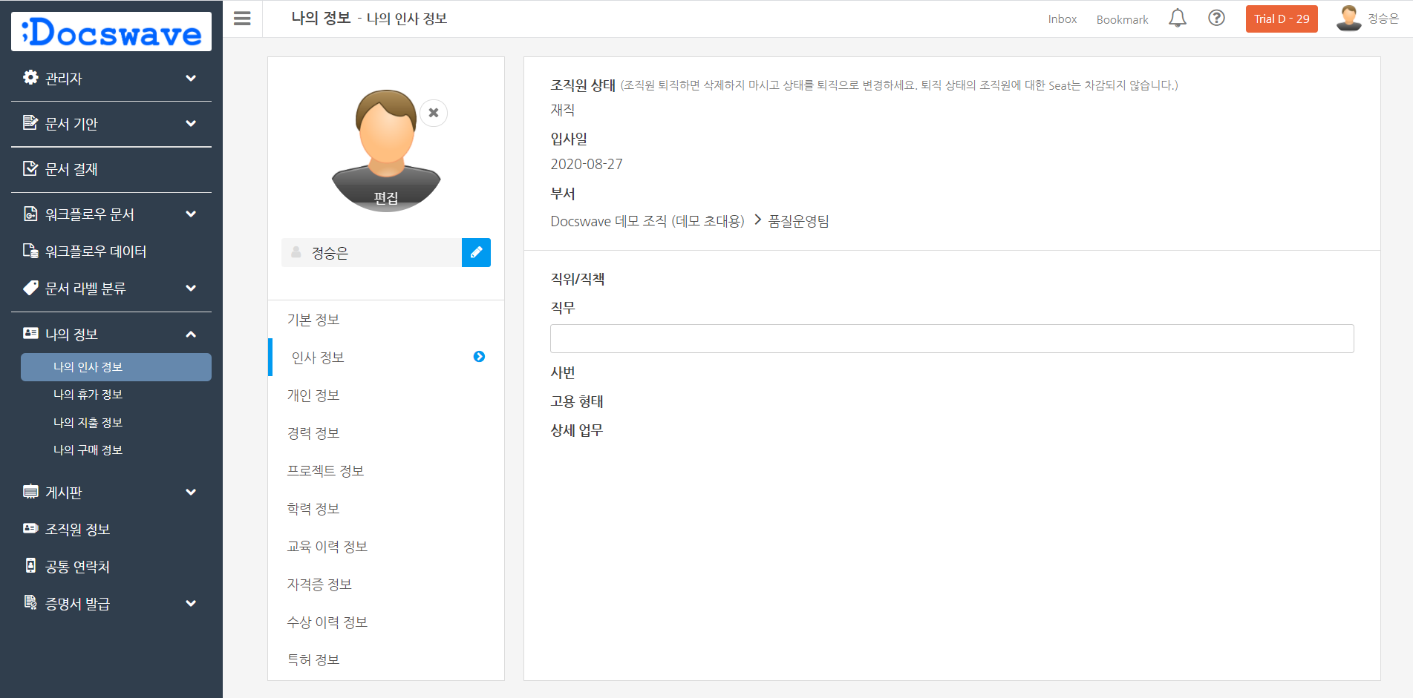
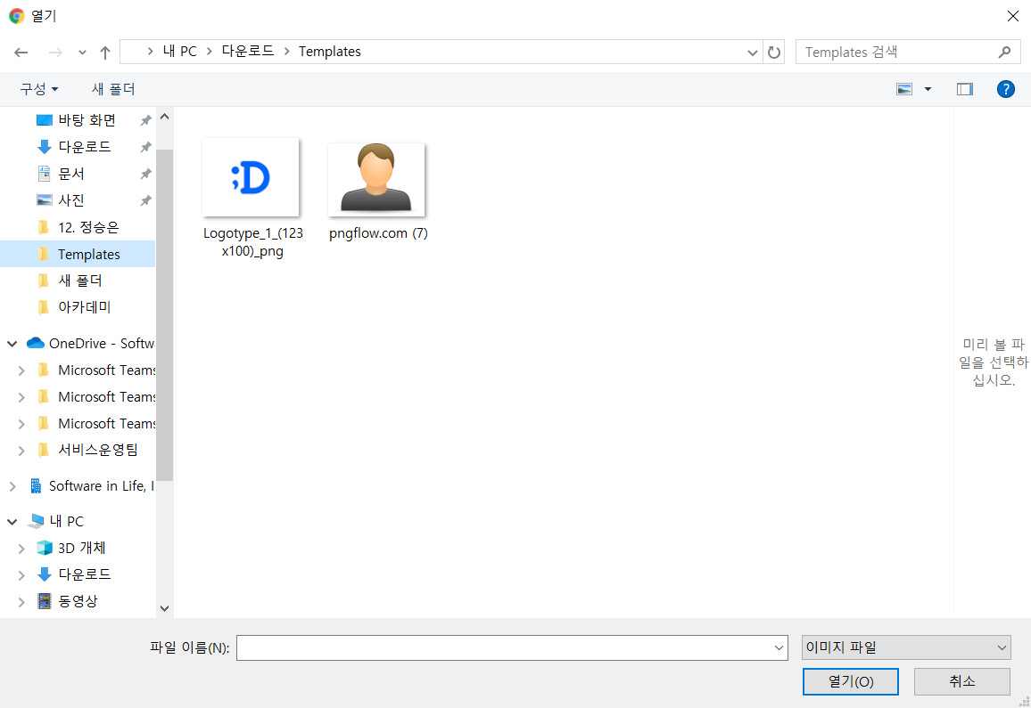
My Info
Setting my HR information (profile image)
Go to ‘My info’ > ‘My profile’
Click [Edit] on the upper left image.
Upload an image in PC.
2
1
3

Slide 13
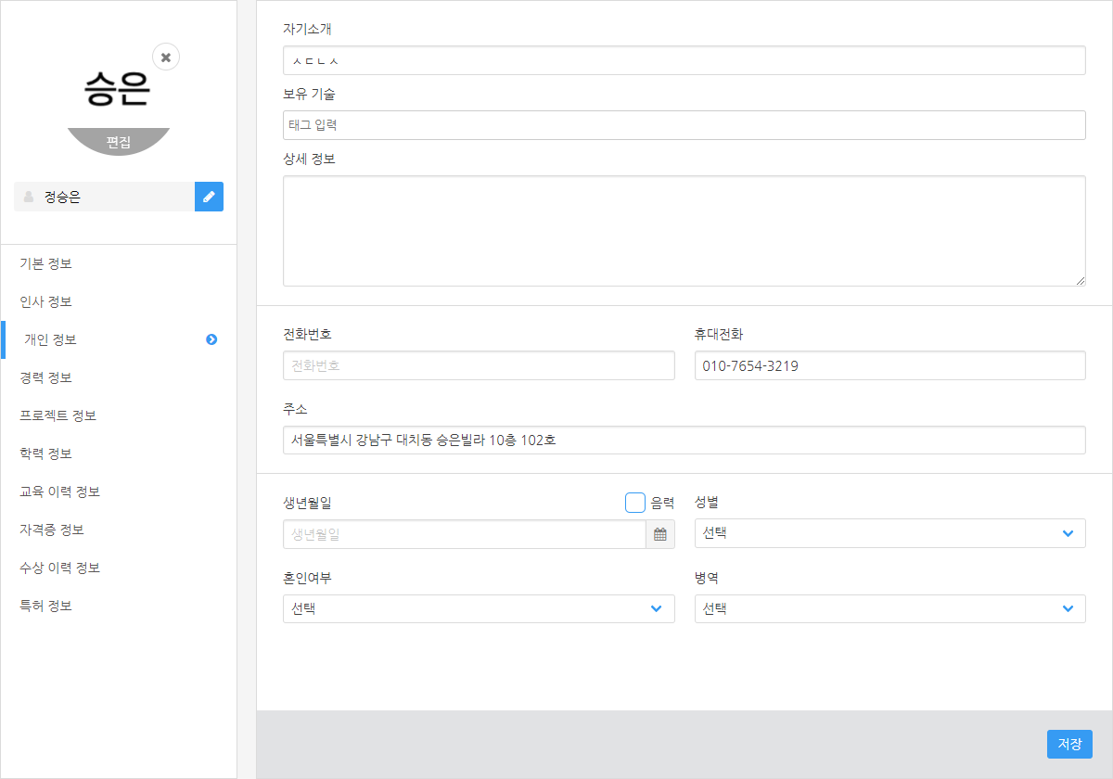
My info
Setting my HR information (Telephone No.)
Go to [my profile – Privacy] tab.
Type contents in text box.
For possessive technology, enter each unit separated by an Enter key or , (comma) key.
Click ‘Save’ button on bottom side.
1
2
3

Slide 14
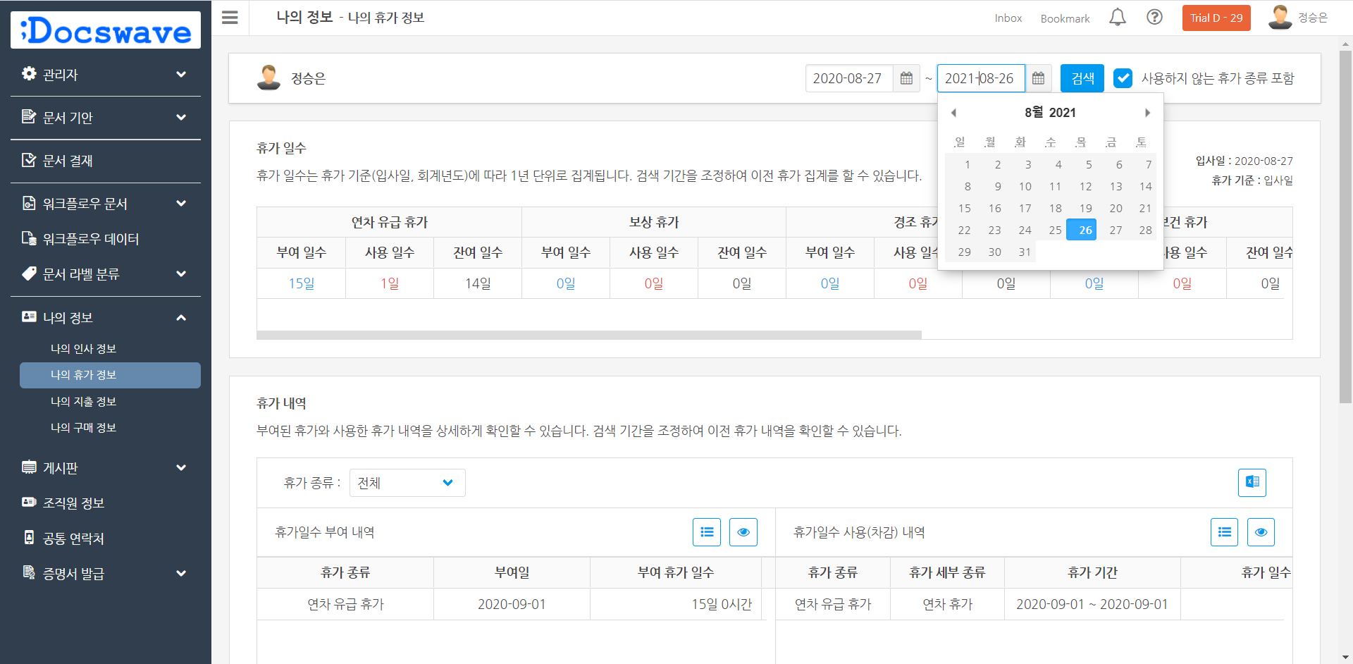
My Info
Checking my Vacation history
3
Go to ‘My info’ > ‘My leave information’
Designate dates from the upper right side. (Maximum : 1 year)
Click the search button.
Check your ‘vacation days’ by ‘vacation type’. (Final approved documents only are counted)
2
1
4

Slide 15
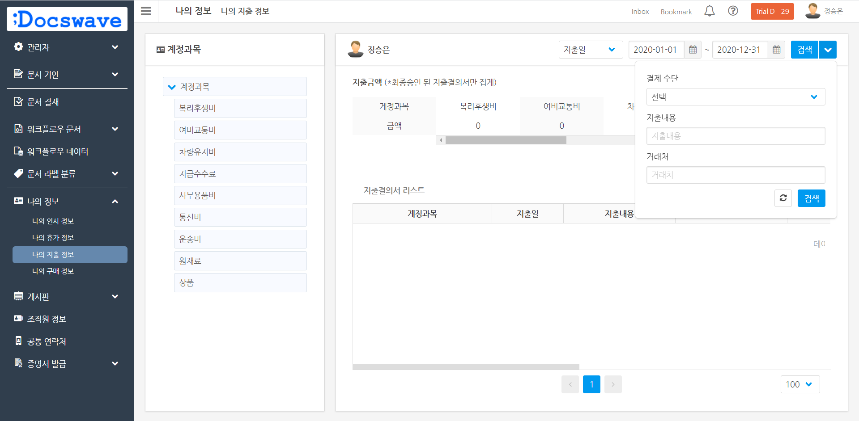
My Info
Checking my spending documents
Go to ‘My info’ > ‘My spending information’
Designate search criteria from upper right side, then click 'Search' button.
Check amount by ‘account subject.’ (Only the final approved documents are counted)
2
3
1

Slide 16
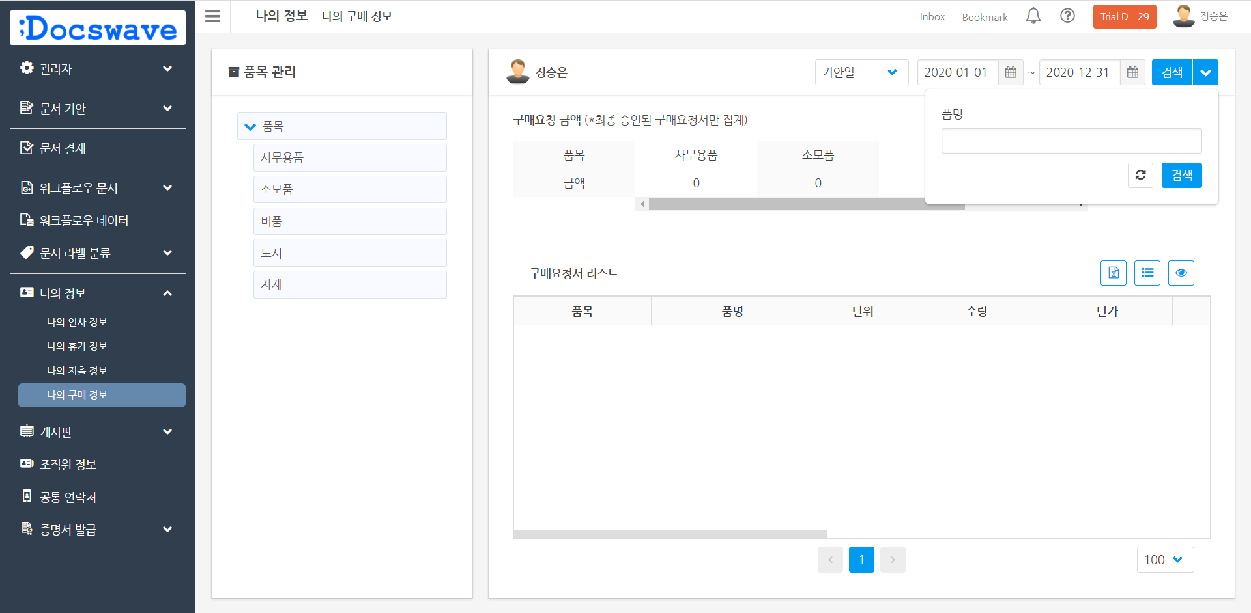
My Info
Checking my purchase information
Go to ‘My info’ > ‘My purchase information’
Click 'Magnifier' icon on the upper right side, Set search criteria, and click 'Search' button.
Check amount by ‘account subject’. (Only the final approved documents are counted)
2
엑셀 다운로드
3
1

Slide 17
3. Workflow Document
Making documents.
Approving/Rejecting documents.
How to create document again
Using workflow data
How to print at once

Slide 18
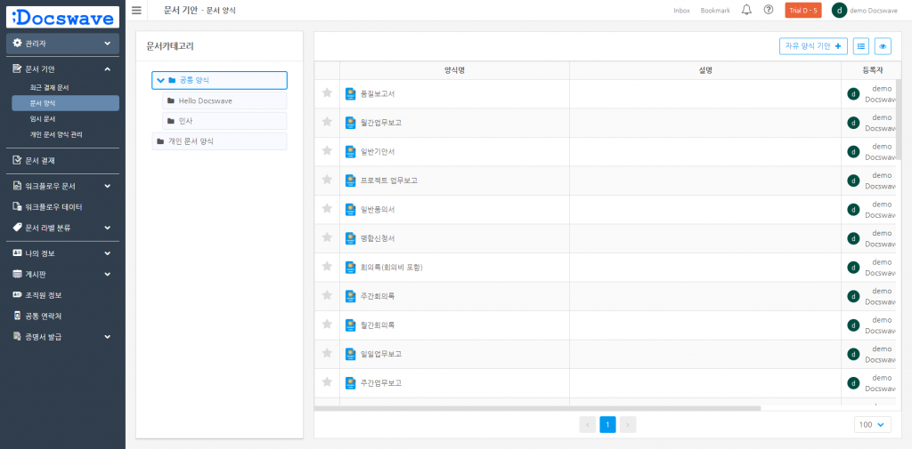
Workflow document
Writing documents
Selecting a form
Go to ‘Document drafted’ > ‘Docs Forms’
Select a form in document list.
1
2

Slide 19
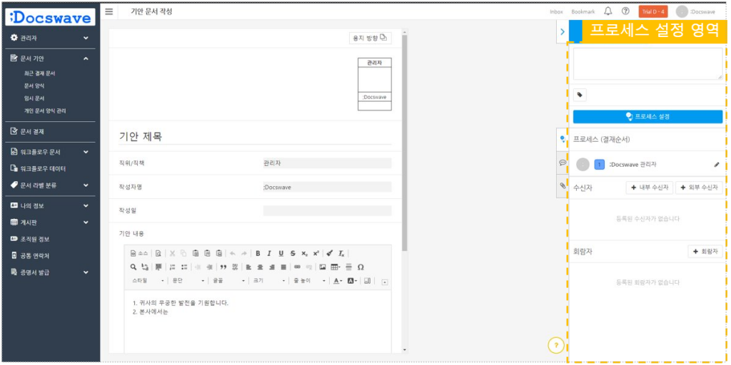
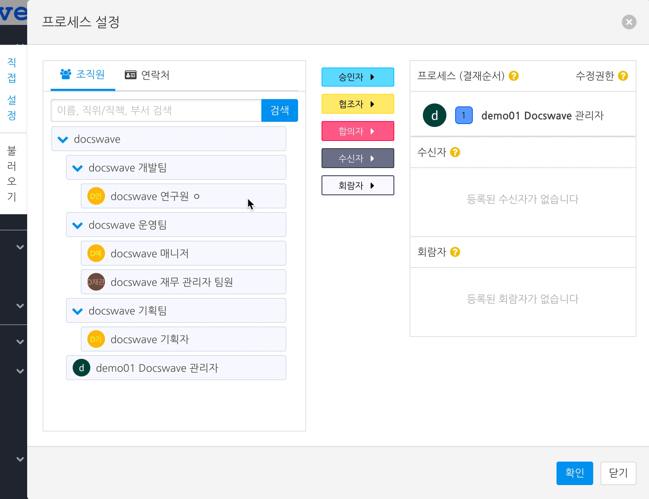
Workflow document
Setting processes
Adding ‘Approver’, ‘Cooperator’, and ‘Consenter’
‘Approver’, ‘Cooperator’, and ‘Consenter’ are approvers who can approve or reject documents.
Use these settings by how your group is.
Approver : Approvers who are directly related to the document.
Cooperator : Approvers in relevant departments who required to cooperate to the document.
Consenter : Same with cooperator, but when multi-people approval is needed.
Select members in organization chart or group member tab.
Click [Approver / Cooperator / Consenter ▷]

Slide 20
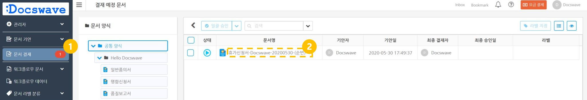
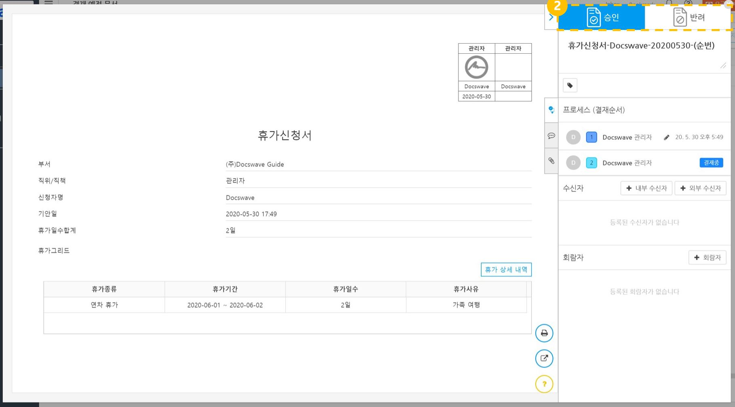
Workflow document
Approval / Rejection of documents
Go to ‘Document approval’ menu.
Click the title of document you will approve.
Read text and Click ‘Approve’ or ‘Reject’ button.
1
2
3

Slide 21
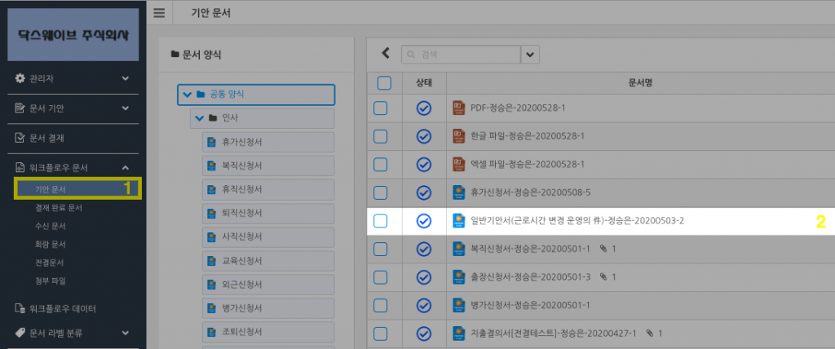
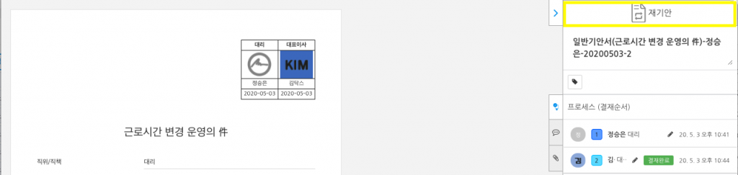
Workflow document
How to create document again
You can create documents again through the final approved documents of the creater's own.
Go to ‘Document drafted’ > ‘Recently approved document’
Click a document you want to create again
Create a new document based on current document.
1
2
3

Slide 22
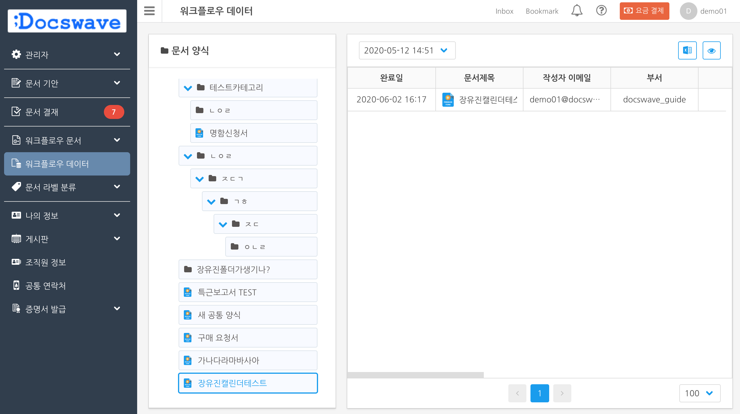
Workflow document
Checking workflow data
You can see data of approved documents you’ve written(made by premium forms) in statistics.
Go to ‘Workflow data’ menu.
Select a docs forms category you want to check. Common form Private document form
[Select a form in the category.
Check [form version] in the right side.
View workflow data for the selected common form

Slide 23
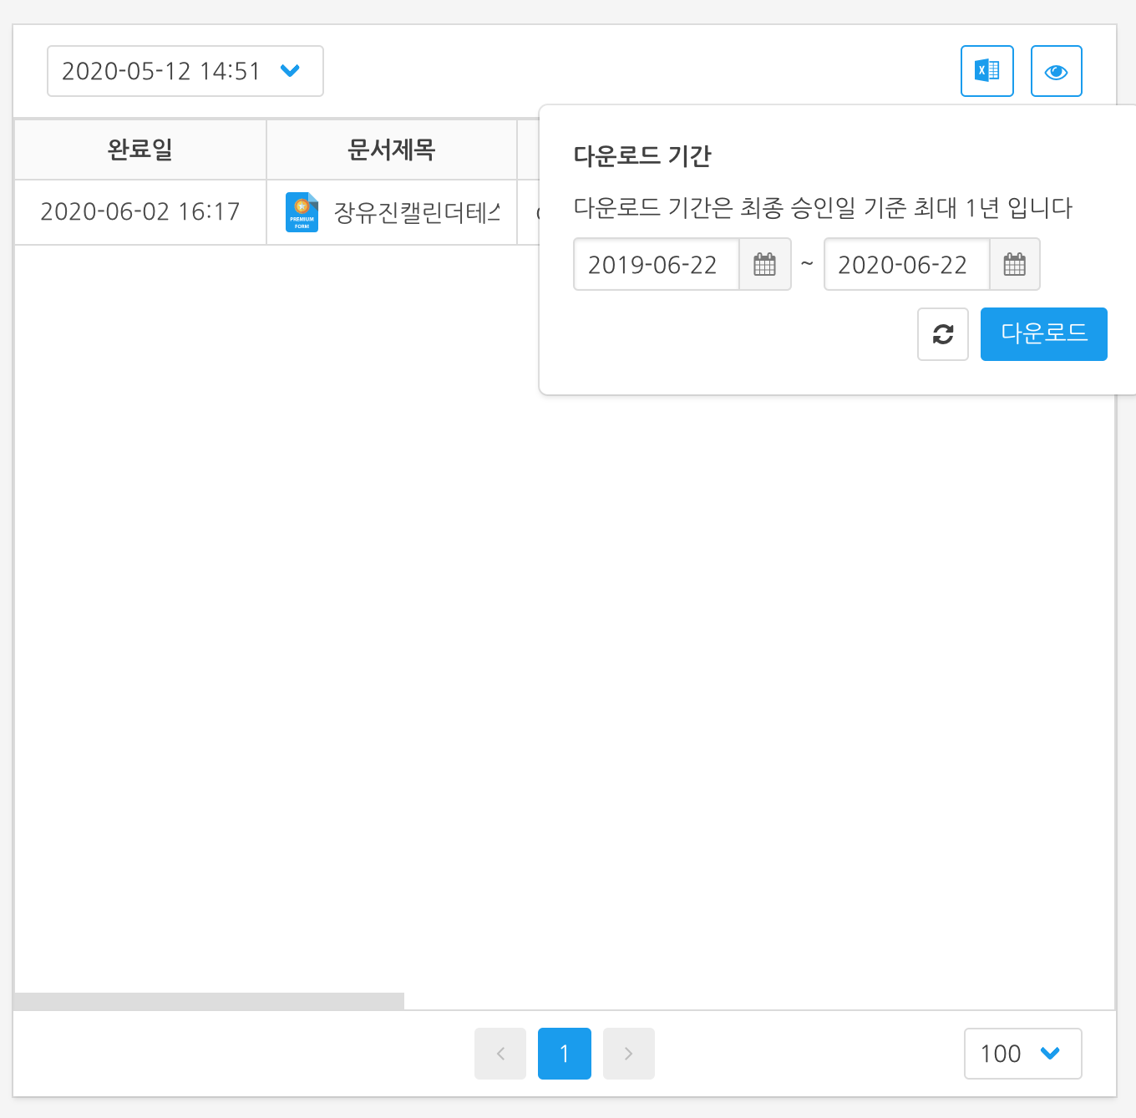
Workflow document
Downloading workflow data in Excel files.
You can download document data within one year of the final approval date.
Go to ‘Workflow data’ menu.
[Select a docs forms category you want to check.
[Select a form in the category.
Check [form version] in the right side.
Click [Excel[ button on the upper right side.
Select download period.
[Click ‘Download’ button.

Slide 24
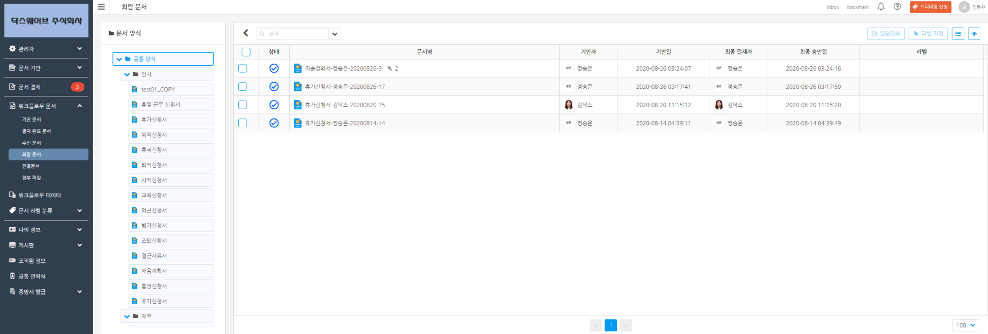
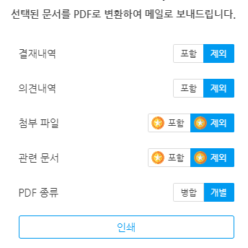
Workflow document
How to print at once
You can print several documents together with ‘Print at once’ feature.
Go to ‘Workflow document’ > the menu where documents you want to print are.
Check documents you want to print.
Click ‘Print at once’ button on top.
Set options for printing at once.
Click ‘Print’ button.
Check files sent by e-mail. (It will take 5~10 mins depending on number of files)
3
1
2
4

Slide 25
4. Board Collaboration
Cooperate with boards

Slide 26
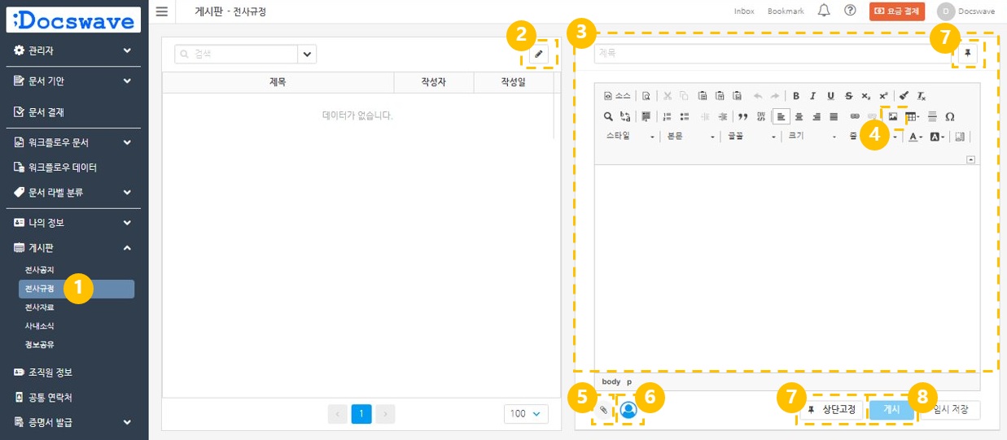
Board
Cooperate with boards (Writing posts)
Go to ‘Board’, select a board where you want to post
Click [Pen] button on upper right
Write title and text
Upload images in text if you need to. You can upload [images] using drag & drop.
Upload [attachments in post] if you need.
Can designate [members to be notified]
Click a tack icon if you want to make your post to be [fixed on top]. Fixed post will be displayed on top always.
Click ‘Posting’ button on the bottom.

Slide 27
5. Issue a certification
Certificate application

Slide 28
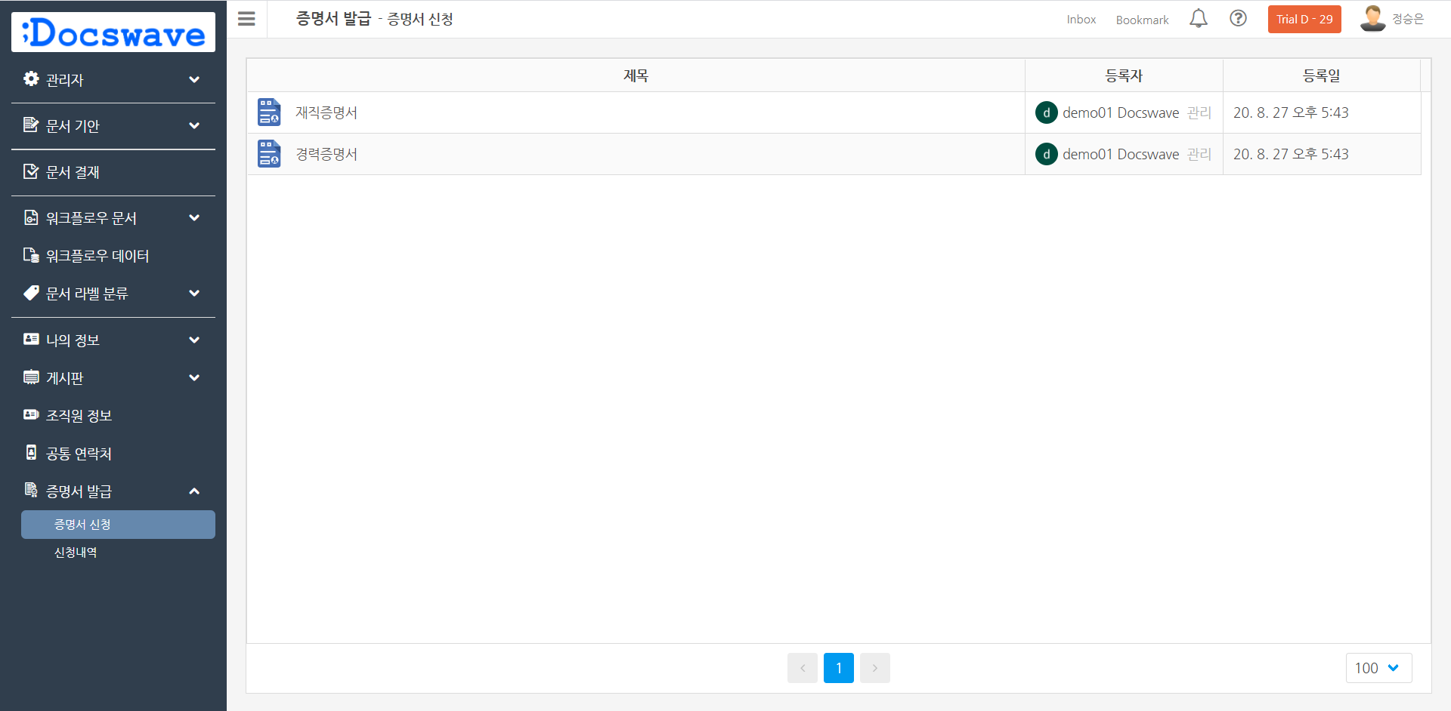
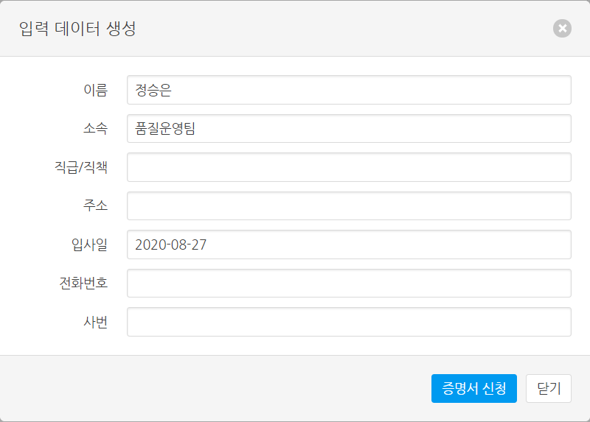
Issue a certification
Certificate application
2
Go to ‘Issue a certificate’ > [Certificate Application]
Click the name of certification that you want to apply
Fill in blanks with information in generated form.
Click [Certificate Application] button.
3
1
4

Slide 29
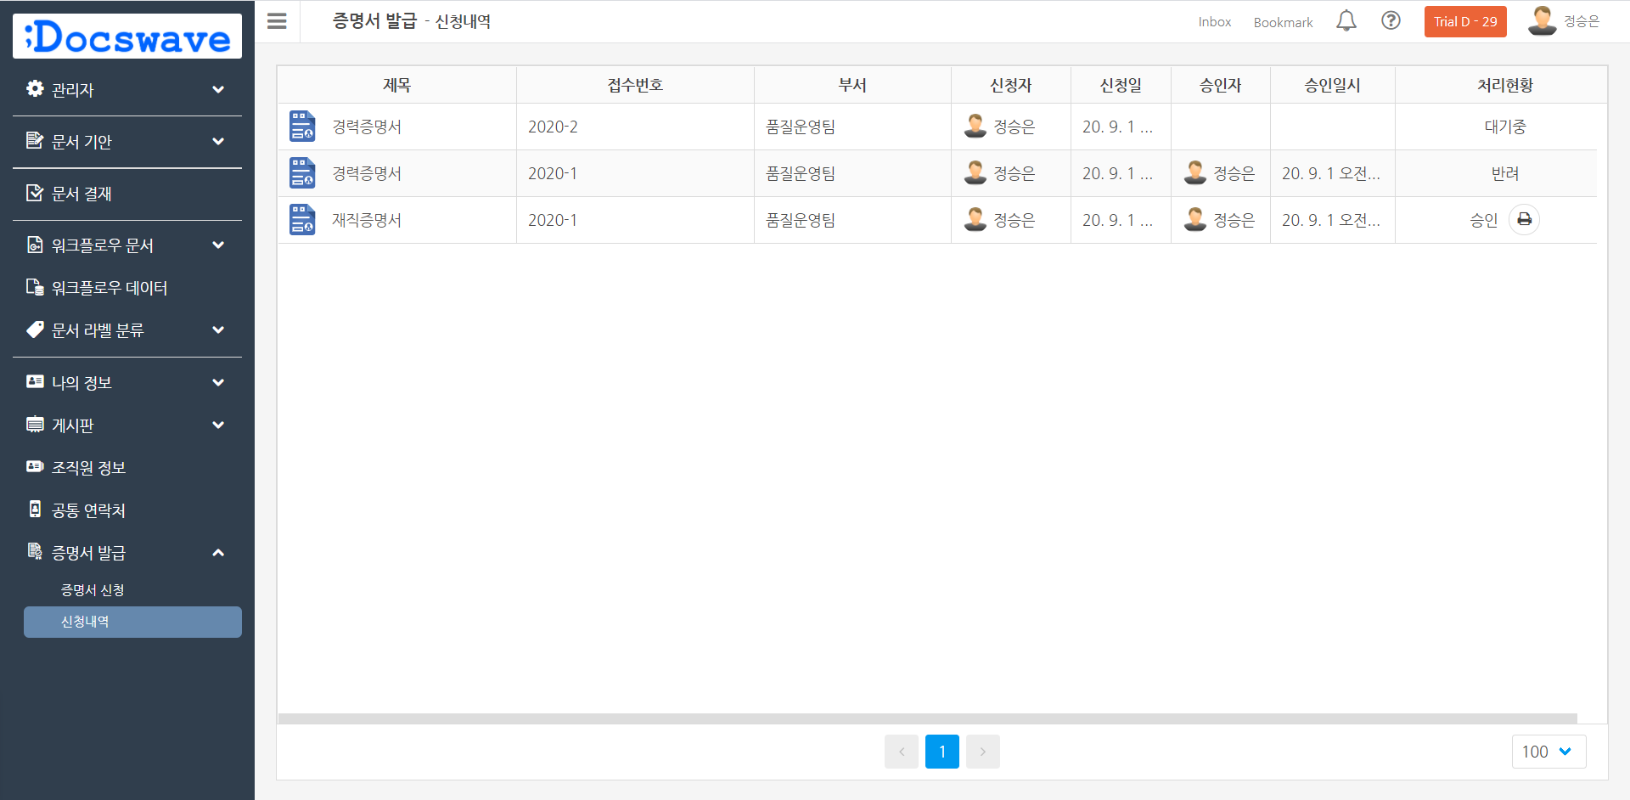
Issue a certification
Certificate Application History
Approved certifications : Can be printed
Rejected certifications : Can not be printed, and reasons for rejection is displayed together.
Certifications in progress : Is not approved or rejected.
Go to ‘Issue a certificate’ > [List of application]
Check your application list
2
1

Slide 30
6. Member Info & Shared Contacts
See member details
Shared Contacts

Slide 31
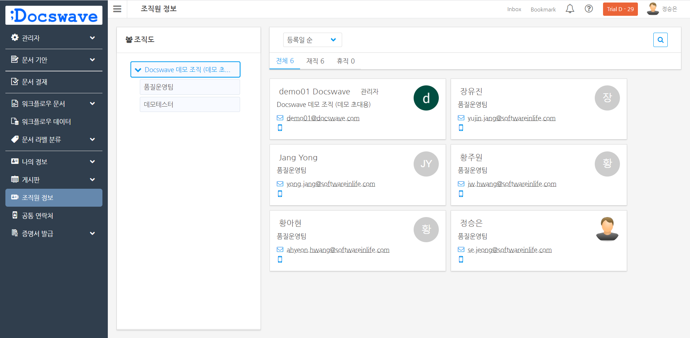
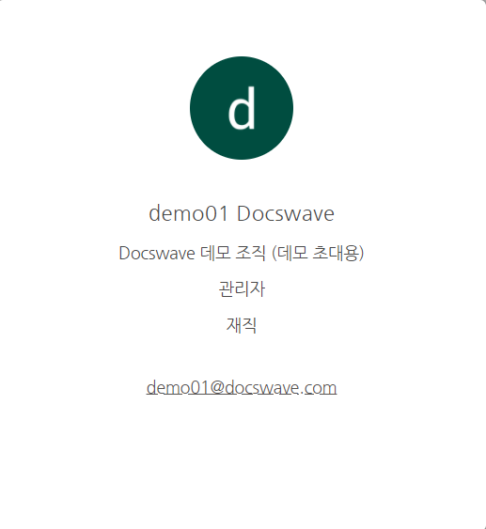
Member info & Shared Contacts
See member details
Go to ‘Member info’.
Click the ‘name of the member’ you want to see.
2
1

Slide 32
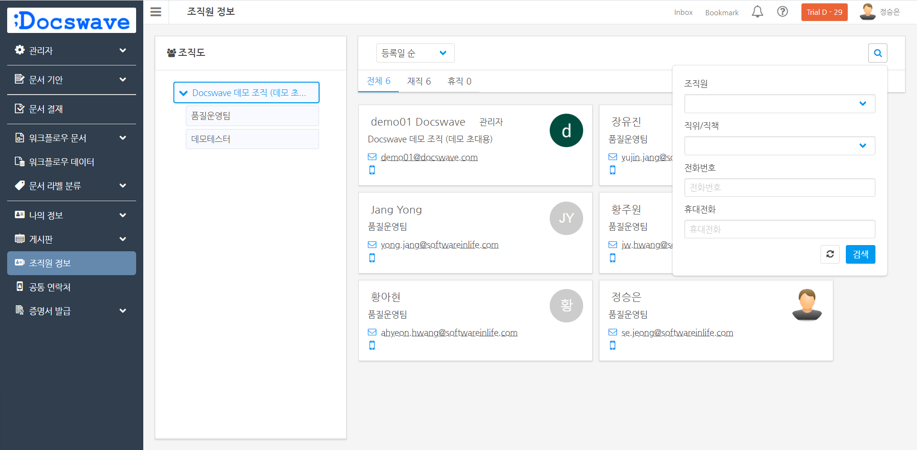

Member info & Shared Contacts
Searching member info
2
Go to ‘Member info’.
Click magnifier icon on the upper right side.
Search with condition.
  Memver name
  Tittle/Position
  Telephone No.
  Cell phone
Click [Search] button
Click [Return] button if you want to choose condition again.
3
1
4
5

Slide 33
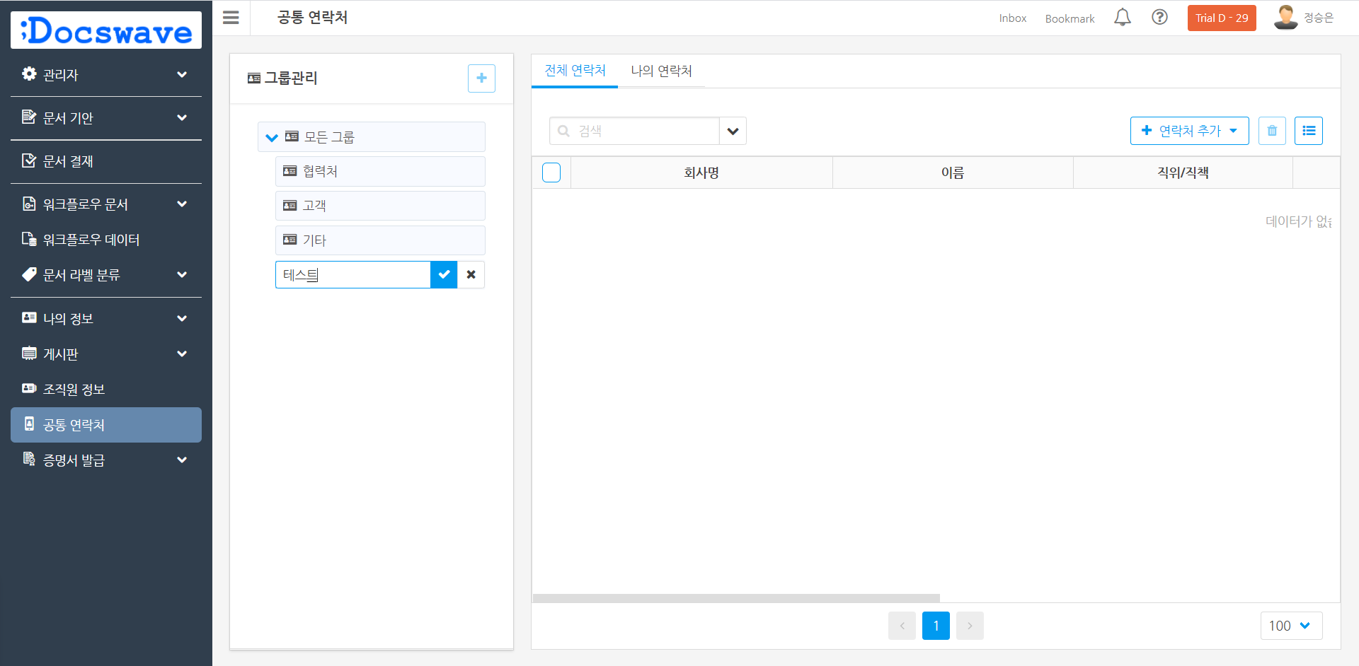
Member info & Shared Contacts
Shared Contacts(Adding a new group)
Go to ‘Shared Contacts’ menu.
Click [+] button on upper left side.
Type group name. Click [v] button.
2
3
1

Slide 34
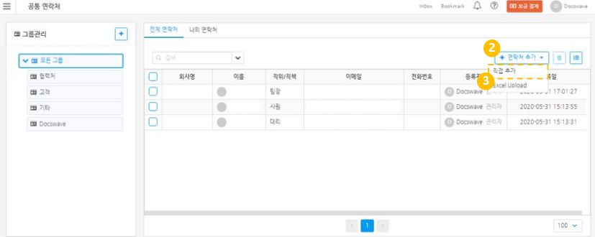
Member info & Shared Contacts
Shared Contacts(Adding contacts directly)
Go to ‘Shared Contacts’ menu.
Click ‘+Add contact(s) ▼’ button.
Click ‘Add contacts’ button.
Fill in blanks. ‘Name’ is essential.
Click [add] button.

Slide 35

Thank You!
(+82) 1522-8752
support@docswave.com
;Docswave Guide

